Slide 1
Investigating Basic Circuits
Pre-Activity Discussion
Digital Electronics
© 2014 Project Lead The Way, Inc.

Slide 2
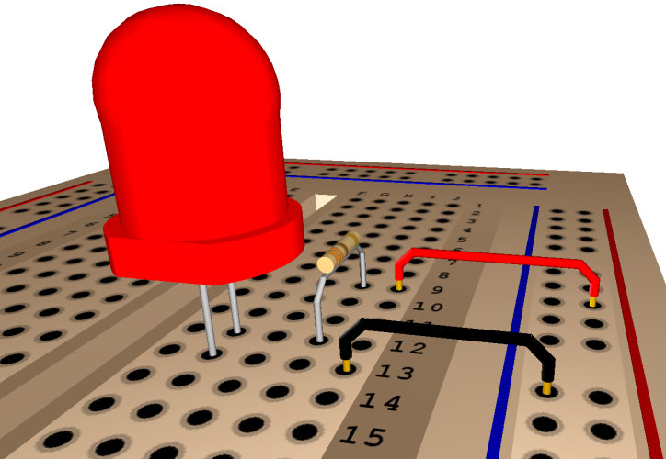
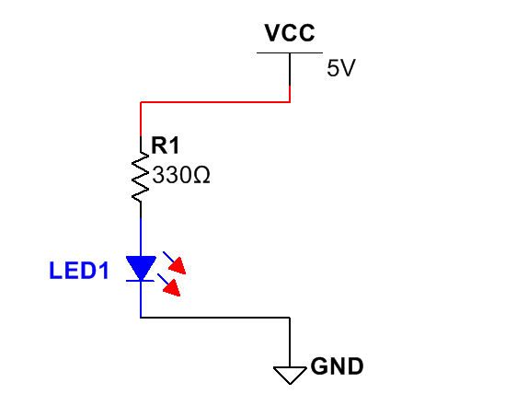
This Presentation Will…
Introduce you to basic circuits and their symbols.
Introduce you to components and equipment that are fundamental to understanding circuits.
Define voltage, current, and resistance.
Prepare you for Activity 1.1.2 Investigating Basic Circuits
Notes:
Introductory Slide / Overview of Presentation

Slide 3
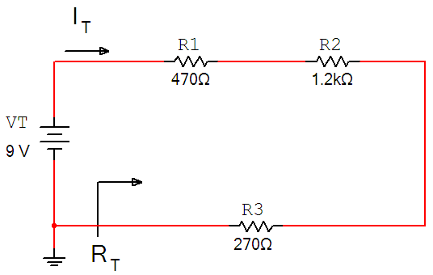
Investigating Basic Circuits
You may have studied electricity and circuits in others classes.
Physical Science
PLTW – Gateway – ME
Chemistry
Physics
This guided activity assumes that you have no prior knowledge of electricity.
If you have studied circuits before, it can act as a refresher to help you start thinking about circuits again.
Notes:
Introductory Slide / Overview of Presentation

Slide 4
Reflective Questions
Throughout this activity keep considering…
What are some of the basic components that make up simple circuits and what do they do?
What are the important characteristics of a circuit and how do I measure different parts of a circuit?
How do I work safely with circuits?
How do I measure voltage in a circuit?
How does the arrangement of components affect the characteristics of the circuit?
How can I use calculations to design circuits before I start creating one?
Notes:
Introduction to the three basic elements of electricity/electronics

Slide 5

Equipment and Tools
In this activity you will be introduced to the equipment, concepts, and skills that are foundations in the study of electronics.
Components - (Discrete Components) Simple electronic devices that affect electrons in a circuit.
Breadboards - Reusable platforms for prototyping circuits temporarily without soldering.
Measurement Tools – The Digital Multimeter (DMM) is widely used to measure:
Current (I)
Voltage (V)
Resistance (R)
V
+ -
I
R
Notes:
Introduction to the three basic elements of electricity/electronics

Slide 6
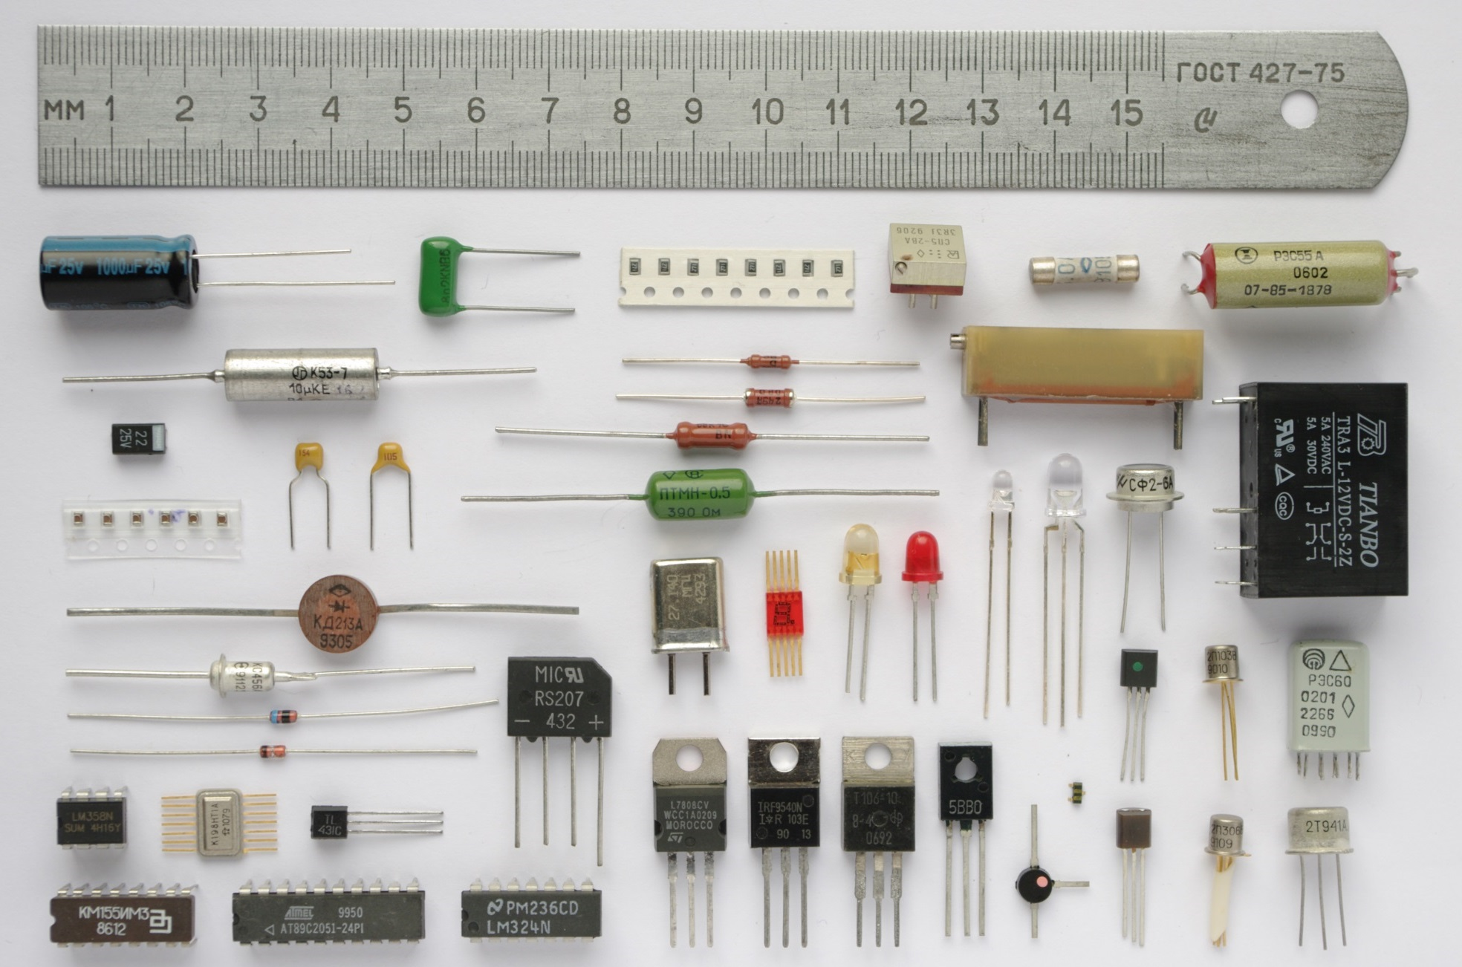
Electronic Components
Notes:
Introduction to the three basic elements of electricity/electronics

Slide 7
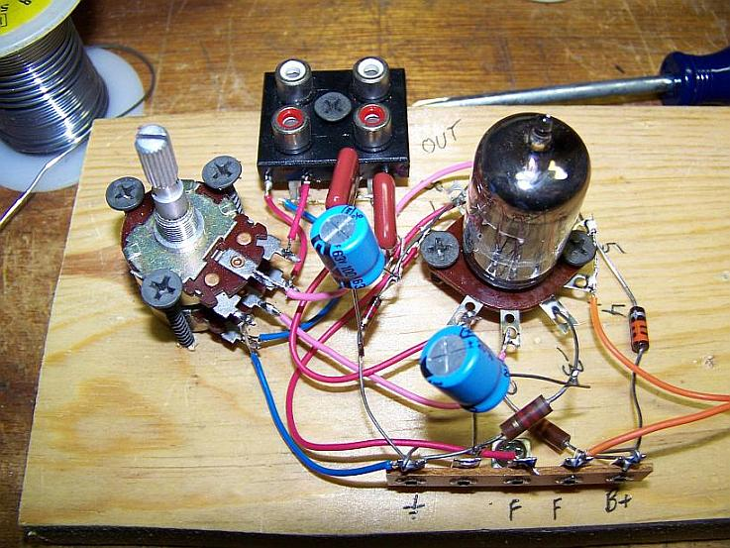
Breadboards
Notes:
This terminology goes waaaaay back to the days of vacuum tubes. Generally, you would mount a number of tube-sockets on standoffs to a piece of wood (the actual "breadboard"), and do all the wiring with point-point wire and the components just hanging between the various devices. If you needed additional connection points, you would use a solder-lug terminal strip.
The story goes that an engineer had an idea for a vacuum tube device late one night. Looking around the house, the only base for his prototype that he found was indeed his wife's breadboard, from the breadbox.

Slide 8
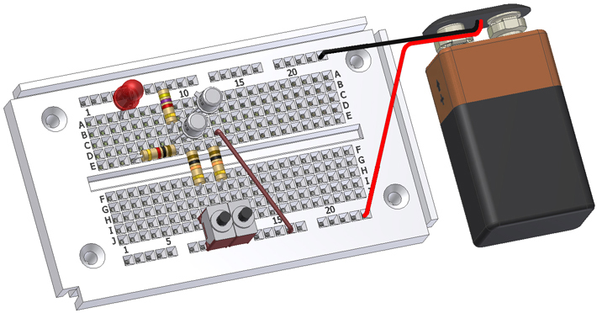
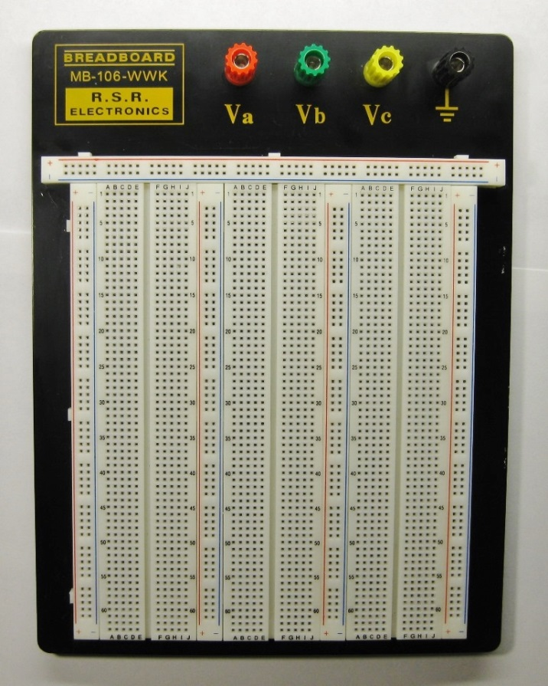
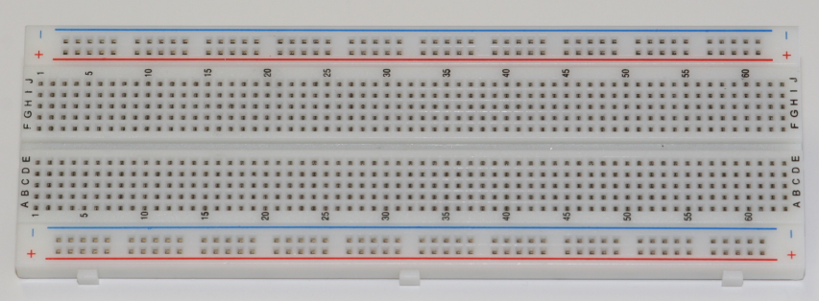
Basic Breadboards
A breadboard, sometimes called a protoboard, is a reusable platform to temporarily build electronic circuits.
Notes:
Introduction to the three basic elements of electricity/electronics

Slide 9
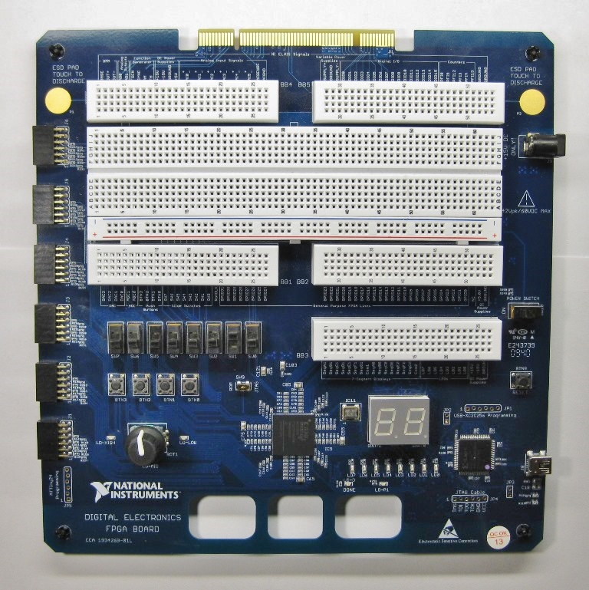
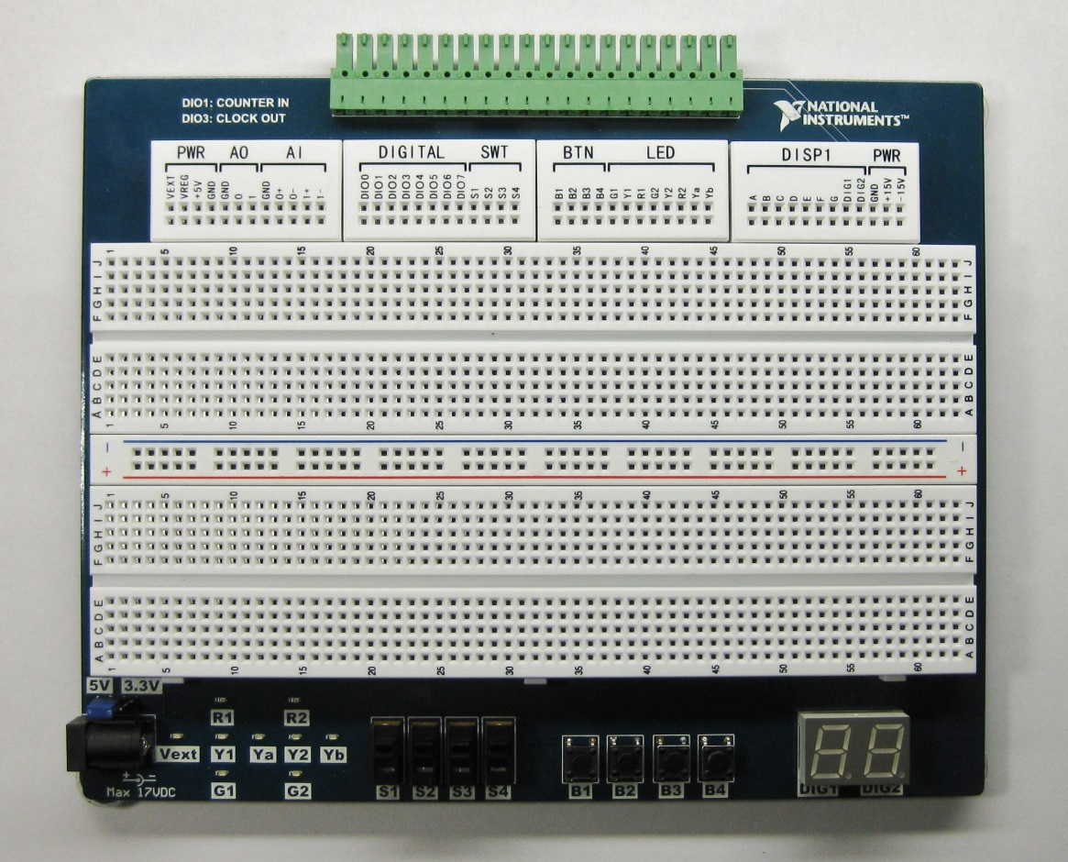
Advanced Breadboards
Digital design tools that already have common components in place for you. They also sometimes have advanced programming ability to create large circuits.
NI Digital Logic Board (DLB)
NI Protoboard
Notes:
Introduction to the three basic elements of electricity/electronics

Slide 10
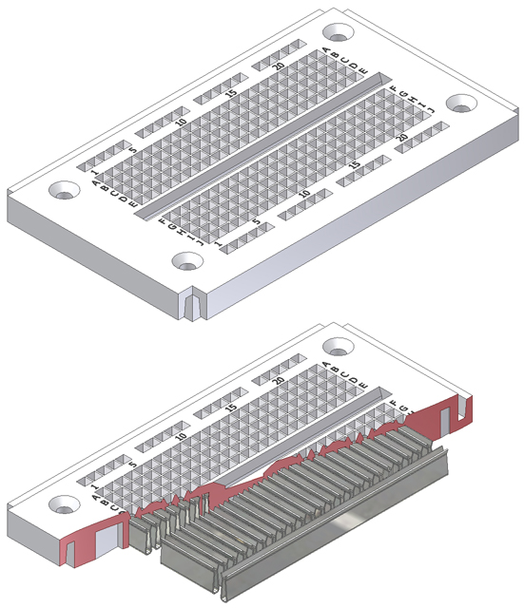
How a Breadboard Works
Electric component leads and the wire used to connect them are inserted into holes that are arranged in a grid pattern on the surface of the breadboard.
A series of internal metal strips serve as jumper wires. They connect specific rows of holes.
Top View
Cut-Away View

Slide 11
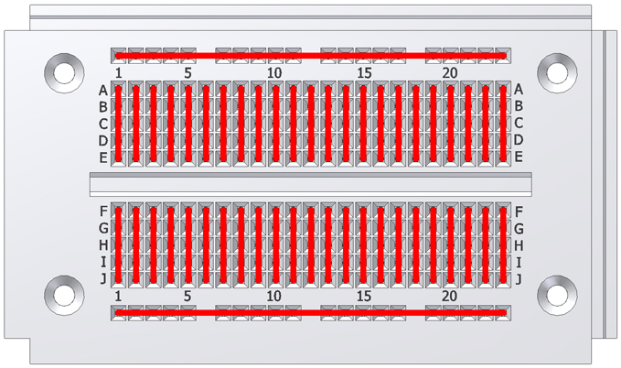
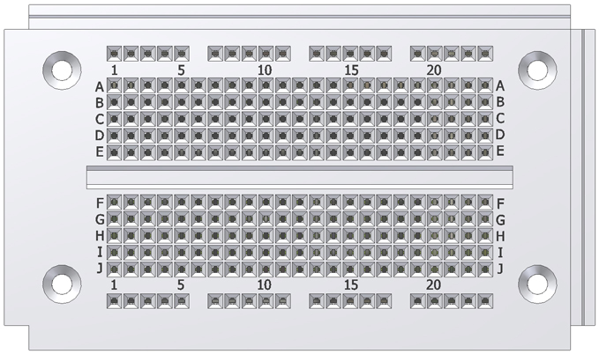
Breadboard Connections

Slide 12
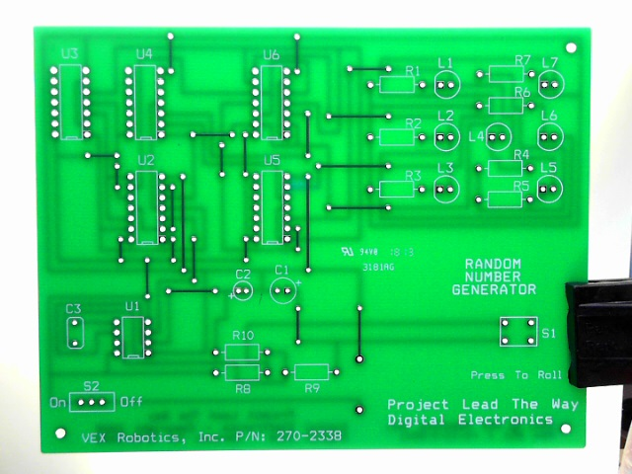
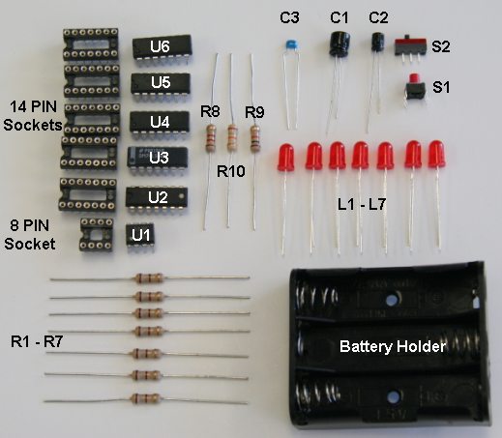
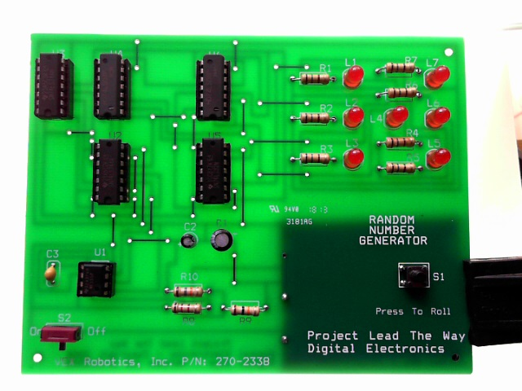
Printed Circuit Boards (PCB)
Connects electronic components using conductive pathways etched from copper sheets laminated onto a non-conductive substrate.
Components are then attached through soldering.

Slide 13
Why Breadboard?
It takes less time (and money) to breadboard a circuit than to design and fabricate a printed circuit board (PCB).
Because of the cost, a PCB should be reserved for the final working design.
As a complement to circuit simulation, breadboarding allows the designer to see how, and if, the actual circuit functions.

Slide 14
Why Breadboard?
Breadboards give the designer the ability to quickly change components during development and testing, such as swapping resistors or capacitors of different values.
A breadboard allows the designer to easily modify a circuit to facilitate measurements of voltage, current, or resistance.

Slide 15
Breadboard: Guidelines and Tips
Use as few jumper wires as possible. The breadboard should be used to make the majority of the connections between the components.
Keep jumper wires as short as possible. A jumble of wires is difficult to troubleshoot.
Breadboard a circuit so that it looks as close as possible to the layout of the schematic circuit. This makes troubleshooting easier.

Slide 16
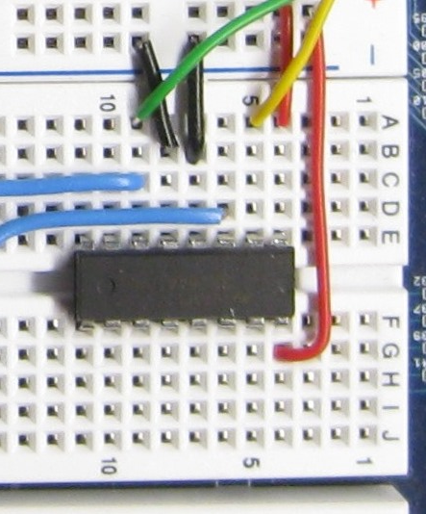
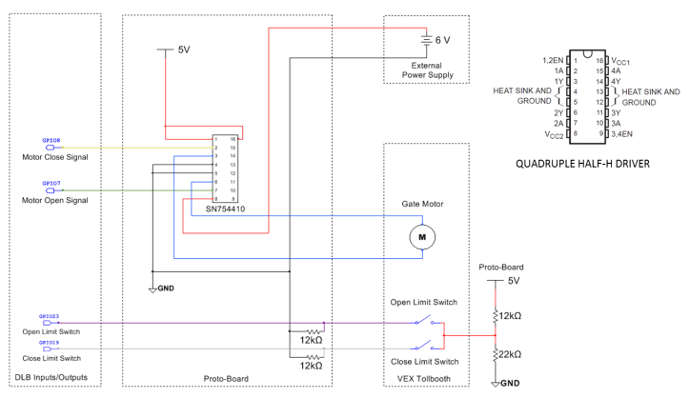
Breadboard: Guidelines and Tips
Place IC chips in the middle of the breadboard.
Work from a schematic and check off the component and wires as they are implemented on the breadboard.
Cut component leads to manageable lengths. Component leads that are too long may touch and short each other out.
Have someone check your circuit for errors.

Slide 17
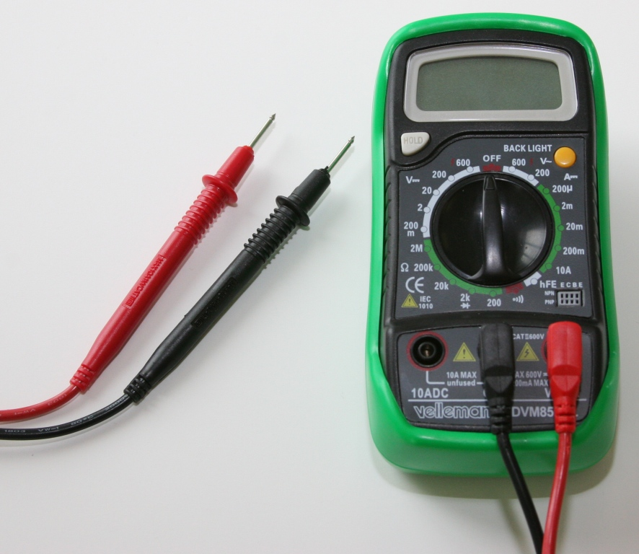
Digital Multimeters (DMM)
Used to measure Voltage, Current, and Resistance
Symbol
(V ---) Voltage Direct Current
(V ~) Voltage Alternating Current
(A ---) Current
(Ω) Resistance
In this activity you will learn how to measure voltage.
Traditional Digital Multimeter (DMM)
Notes:
Introduction to the three basic elements of electricity/electronics

Slide 18
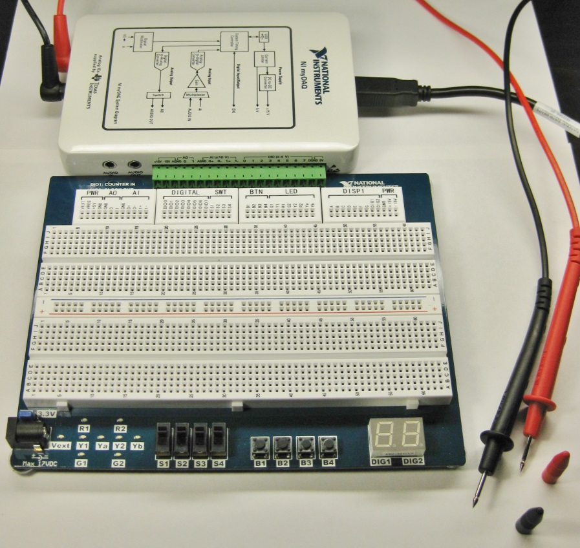
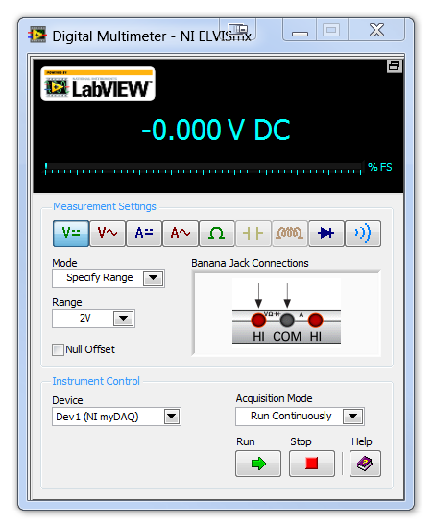
Digital Multimeters (DMM)
Data Acquisition Modules (DAQs) turn your computer into many useful tools that were typically different pieces of equipment in the past. (Including a DMM)
Digital MiniSystem (DMS)
NI myDAQ + Protoboard
Digital Multimeter (DMM)
Notes:
Introduction to the three basic elements of electricity/electronics

Slide 19
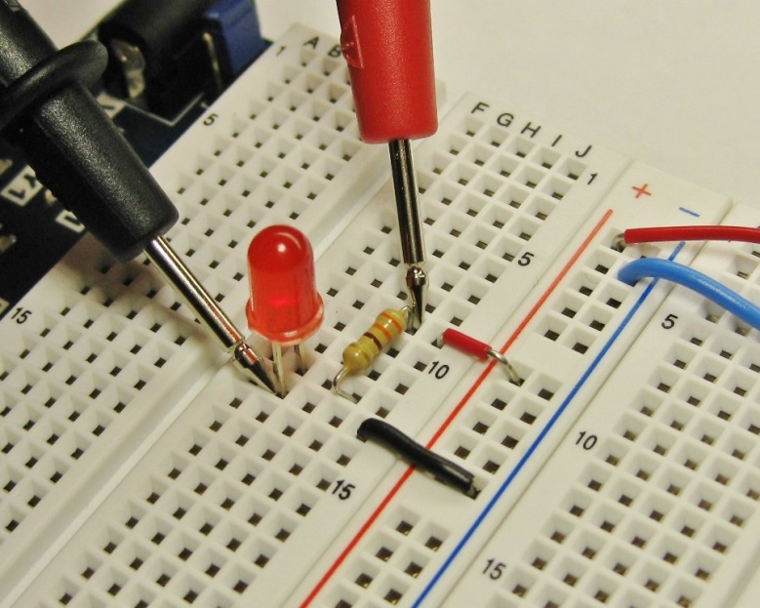
How to Properly Use a DMM
It is critical to understand the proper way to measure
Current (I)
Voltage (V)
Resistance (R)
Placing the leads (red and black) in the improper place will give you incorrect readings and possible damage the DMM
In this activity you will learn to accurately measure voltage.
Notes:
Introduction to the three basic elements of electricity/electronics

Slide 20
Circuit Diagrams
In this activity you will be introduced to the basic components of a circuit and how they are arranged. Each component has a symbol that can be used to create a circuit diagram.
Circuit diagrams and calculations help a circuit designer figure out the characteristics of the circuit before they begin prototyping or breadboarding the circuit.
Notes:
Introduction to the three basic elements of electricity/electronics

Slide 21
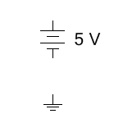
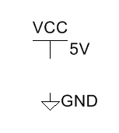
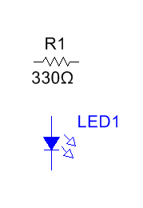
Circuit Diagram Symbols
Analog Power Sources
+
Voltage Source
Ground
-
Digital Power Sources
In this circuit example, we imagine the flow of conventional current to be a positive charge (+) moving from the positive terminal of the battery to the negative terminal of the battery or ground.
A circuit must have a complete path from voltage source to ground.
Voltage Source
Digital Ground
Discrete Components
Resistor
Light Emitting Diode
Notes:
Introduction to the three basic elements of electricity/electronics

Slide 22
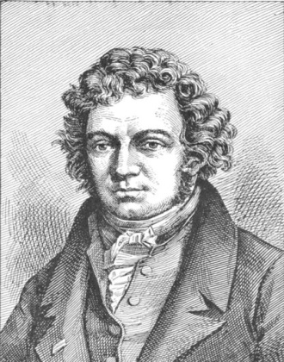
Voltage, Current, & Resistance
Current – Current is the flow of electrical charge through an electronic circuit. The direction of a current is opposite to the direction of electron flow. Current is measured in AMPERES (AMPS).
Andre Ampere
1775-1836
French Physicist
Notes:
The formal definition of current and the scientist that bears their name.
http://commons.wikimedia.org/wiki/Image:Andre-marie-ampere2.jpg

Slide 23
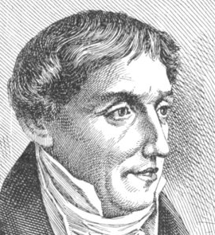
Voltage
Voltage – Voltage is the electrical force that causes current to flow in a circuit. It is measured in VOLTS.
Alessandro Volta
1745-1827
Italian Physicist
Notes:
The formal definition of voltage and the scientist that bears their name.
http://commons.wikimedia.org/wiki/Image:Alessandro_volta2.jpg

Slide 24
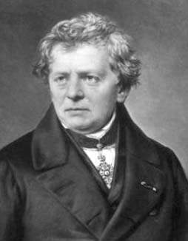
Resistance
Resistance – Resistance is a measure of opposition to current flow. It is measured in Ohms.
Georg Simon Ohm
1789-1854
German Physicist
Notes:
The formal definition of resistance and the scientist that bears their name.
http://commons.wikimedia.org/wiki/Image:Ohm3.gif

Slide 25
Reflective Questions
Throughout this activity keep considering…
What are some of the basic components that make up simple circuits and what do they do?
What are the important characteristics of a circuit and how do I measure different parts of a circuit?
How do I work safely with circuits?
How do I measure voltage in a circuit?
How does the arrangement of components affect the characteristics of the circuit?
How can I use calculations to design circuits before I start creating one?
Notes:
Introduction to the three basic elements of electricity/electronics

